Slide 1
BP | DESIGN BOOK
Horizon X
Scenario Modeller
Design system and interface concepts for the Upstream Portfolio Scenario Modeller
September 2026 · Version 1.0

Slide 2
BP Colour Palette
Design board pack | Foundation colour system
GREENS
BP Deep Green
BP Dark Green
BP Green
BP Light Green
BP Bright Green
BP Pale Green
White
#003600
#004F00
#007F00
#8EDF00
#CCFF00
#CBF296
#FFFFFF
YELLOWS, AMBERS & ORANGES
BP Yellow
Amber 1
Amber 2
Amber 3
Deep Orange 1
Deep Orange 2
Deep Orange 3
#FFE600
#C47400
#FF9A00
#FFD77C
#C80000
#FF4116
#FFB29A
BLUES & PURPLES
Blue 1
Blue 2
Blue 3
Deep Blue 1
Deep Blue 2
Deep Blue 3
Purple 1
Purple 2
Purple 3
#0089A8
#14BFC8
#A3EDEA
#004BAA
#0070FF
#AFECFF
#64009C
#983DC9
#E6C6FF
WARM GREYS
Warm Grey 1
Warm Grey 2
Warm Grey 3
Warm Grey 4
Warm Grey 5
Warm Grey 6
#F7F8F0
#E1E3D6
#BBBCAA
#828474
#494736
#121000
29 colours · Hex values as defined in the BP colour dictionary

Slide 3

Key User Workflow
Four screens, and the alternative routes users take through them
1
2
3
4
Home
ENTRY POINT
Portfolio Viewer
REVIEW AND SHORTLIST
Build a Scenario
CONFIGURE AND SAVE
Scenario Results
REVIEW THE OUTCOME
User enters the application and lands on the home page
From here they choose their route: portfolio viewer, build or edit a scenario, or review past results
KPI cards and charts on portfolio shape and quality frame the decision
Selecting a data point on any chart or table auto-assigns a green tick
Ticked records build a shortlist in the entity listing table across the bottom third
Shortlisted entities carry region and country metadata for provenance
Switch an entity off to exclude it from the scenario being built
Adjust equity share, chance of success or shift the schedule
Apply per entity, then save the scenario to the browser cache
Opens a layout that mirrors the portfolio analysis screen
KPI cards first, then plots, then a summary of the changes made
ITERATIVE
Shortlist, configure, then return to the viewer and repeat until the scenario is ready to save.
ALTERNATIVE ROUTES · WHERE THE USER CAN ENTER AND HOW THEY MOVE
FULL JOURNEY
review the portfolio, shortlist, build, then read the results
1
2
3
4
Route A
BUILD FIRST
straight to the scenario builder to create a new scenario or edit an existing one
1
3
4
Route B
RESULTS ONLY
jump to the results of a previous scenario run
1
4
Route C

Slide 4
01
PROPOSED DESIGN · SECTION 01 OF 04
Home
Entry Point
Start the journey and choose the appropriate route
Home
Portfolio Viewer
Build a Scenario
Scenario Results

Slide 5
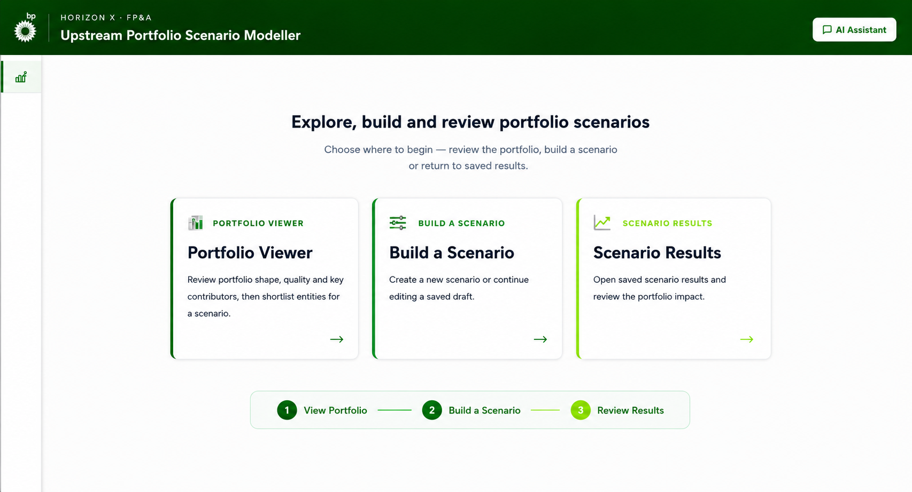
Home Page simplified navigation
PROPOSED DESIGN
CHANGE NOTES
1
Simplified navigation
Four-tile menu reduced to three active destinations aligned to the core user journey
Disabled and overlapping navigation routes removed
1
2
Portfolio review and shortlisting
Portfolio Viewer is a dedicated starting point for understanding portfolio shape, quality and key contributors
Selected entities carry directly into scenario construction
3
Single scenario-building route
New and Edit Scenario combined into one Build a Scenario destination
Start a new scenario or resume a saved draft within the same workspace
2
3
4
4
Clear end-to-end journey
Scenario Results gives direct access to previously saved outcomes
Journey indicator makes the intended flow explicit: View Portfolio → Build a Scenario → Review Results

Slide 6
02
PROPOSED DESIGN · SECTION 02 OF 04
Portfolio Viewer
Review and Shortlist
Analyse portfolio shape and quality, then shortlist entities
Home
Portfolio Viewer
Build a Scenario
Scenario Results

Slide 7
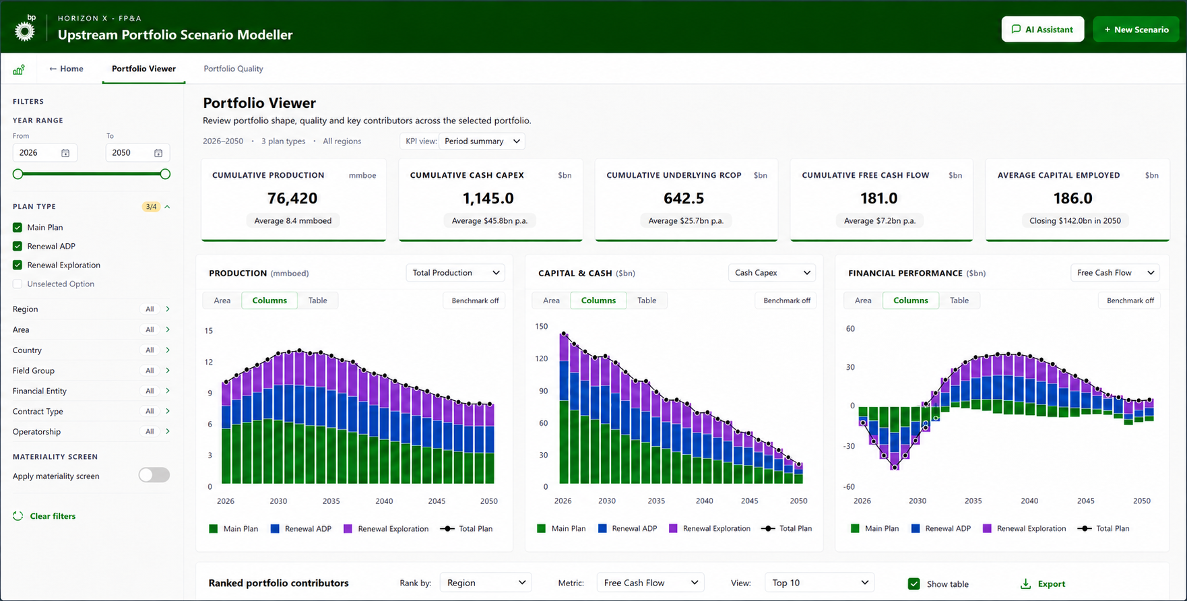
Portfolio Viewer screen height 1 of 3
PROPOSED DESIGN
1
CHANGE NOTES
1
Clear page context
Page renamed Portfolio Viewer, with helper text explaining its role
Context summary shows the selected period, Plan Types and geography
2
2
Decision-focused KPI summary
Selectable KPI view presents selected-period portfolio measures first
Callouts show annual averages or closing values, with units stated
3
3
Flexible portfolio visuals
Consistent chart cards and metric selectors across the three panels
Area / Columns / Table controls choose the presentation
Stacked values show Plan Type composition, with a Total Plan line
Benchmark controls stay hidden until activated
4
4
Expanded filter rail
Adds Area, Field Group, Financial Entity, Contract Type and Operatorship filters
Materiality settings stay collapsed until enabled
Fixed rail keeps analytical context visible as content scrolls

Slide 8
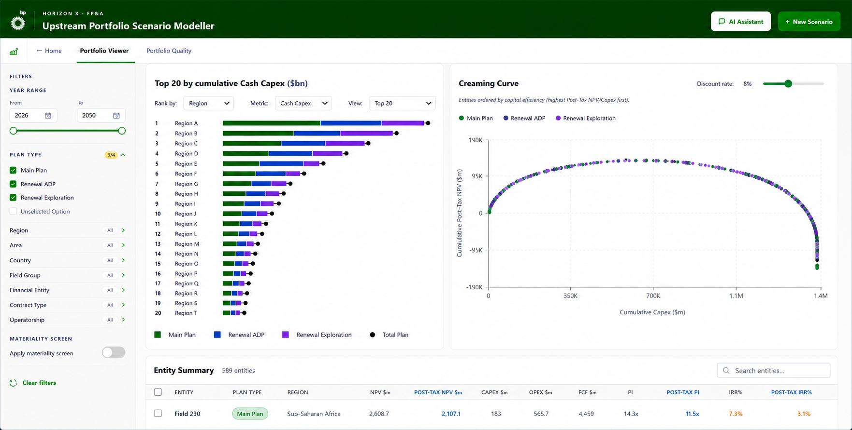

Portfolio Viewer screen height 2 of 3 · on vertical scroll
PROPOSED DESIGN
1
CHANGE NOTES
1
2
1
Persistent analytical context
Header, navigation and filter rail stay fixed while the content scrolls
Selected period, Plan Types and filters remain visible throughout the analysis
2
Prioritisation and linked selection
Ranked Portfolio Contributors and the Creaming Curve give complementary views of scale and capital efficiency
Ranking dimension, metric and Top / Bottom view are selectable, with an adjustable discount rate on the curve
Both visuals respond to the same filters for a consistent basis
Selecting a bar or curve point highlights the entity in the Entity Summary below, supporting shortlisting

Slide 9
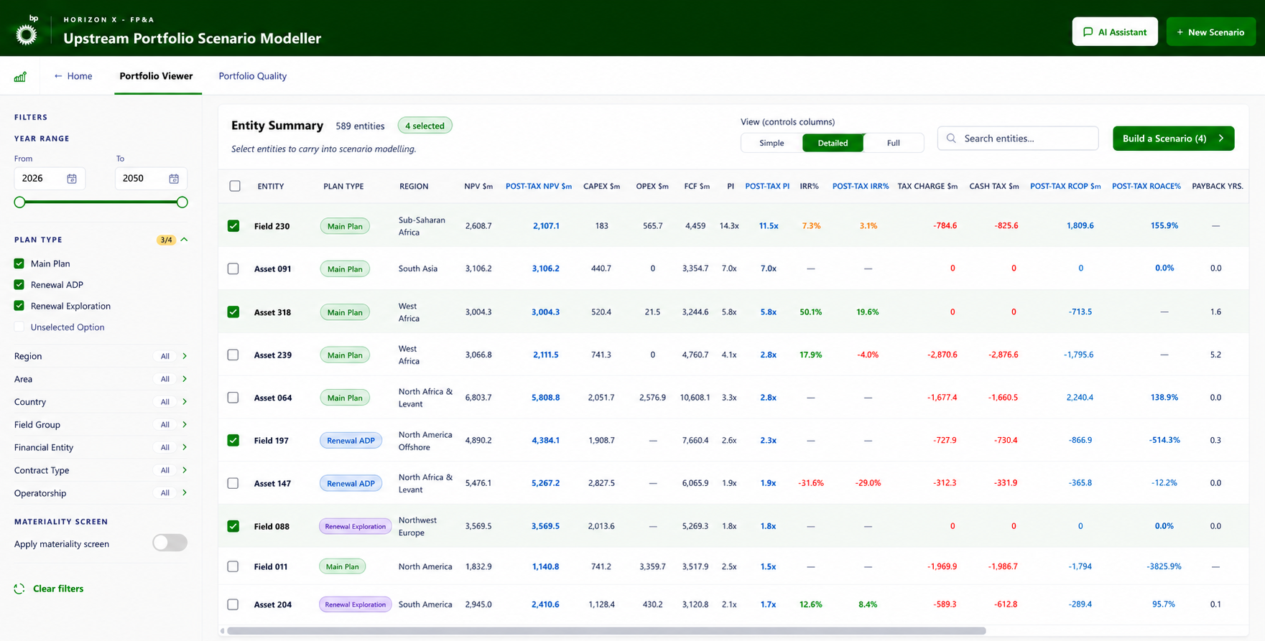
Portfolio Viewer screen height 3 of 3 · on vertical scroll
PROPOSED DESIGN
1
CHANGE NOTES
3
1
Persistent application context
Header, navigation and filter rail remain fixed in the final scroll section
Selected portfolio scope stays visible while entity-level detail is reviewed
1
2
2
Unified entity review and selection
Entity Summary incorporated into Portfolio Viewer, removing the separate Portfolio Quality page
Selectable rows and green selection states make the current shortlist immediately visible
Simple / Detailed / Full views control column density; exact fields can be agreed in development
3
Controlled hand-off to scenario building
Build a Scenario shows the live count of selected entities and carries the shortlist forward
Creates a deliberate transition from review and selection into scenario configuration

Slide 10
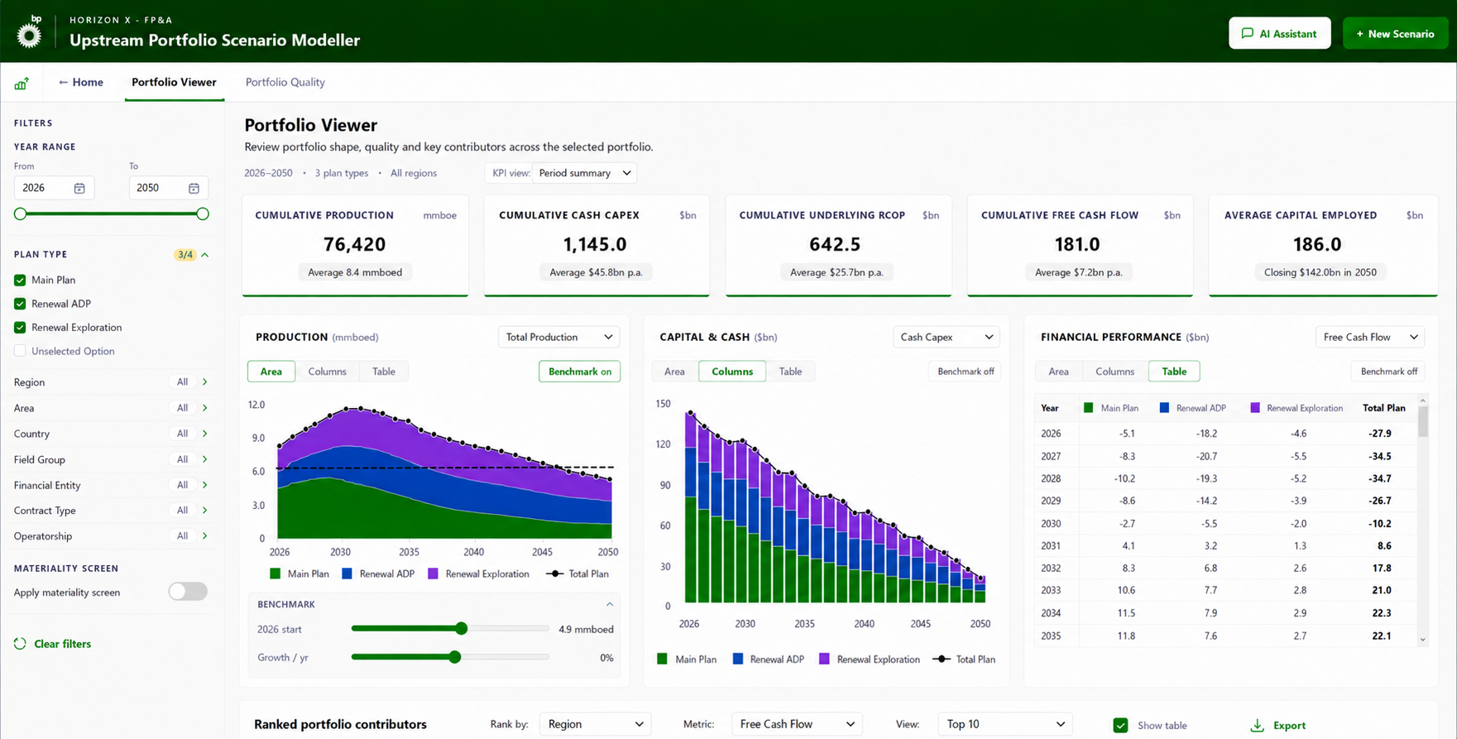
Portfolio Viewer alternative visual types · benchmarking enabled
PROPOSED DESIGN
CHANGE NOTES
1
Independent visual views
Each panel switches independently between Area, Columns and Table views
Here Area is used for Production and Columns for Capital & Cash, so the presentation suits each measure
3
2
Progressive benchmark controls
Enabling Benchmark adds an adjustable guide line to the selected chart
Starting value and annual growth controls appear only when benchmarking is active
1
3
Exact-value table view
Financial Performance switched from chart to table, showing annual values by Plan Type and Total Plan
Exact figures can be inspected without leaving the page or losing filter context
2

Slide 11
Summary of changes all three screen heights
PROPOSED DESIGN
1
SUMMARY OF CHANGES
2
1
Clear page purpose
Portfolio Viewer naming, helper text and context summary establish the page’s purpose and selected scope
Header and navigation remain fixed as the content scrolls
3
2
Decision-focused KPI summary
Selected-period KPI cards surface portfolio totals first, supported by annual averages or closing values and consistent units
3
Flexible visual analysis
Consistent Production, Capital & Cash and Financial Performance panels provide metric selectors and Area / Columns / Table views
Stacked Plan Types retain the Total Plan view, with benchmark controls available when required
4
5
4
Expanded filter rail
Adds Area, Field Group, Financial Entity, Contract Type and Operatorship filters
Materiality controls remain collapsed until enabled, while the filter rail stays fixed during scrolling
5
Portfolio prioritisation
Ranked Contributors and the Creaming Curve compare portfolio scale and capital efficiency using a shared filter context
Linked selections carry chosen entities into the Entity Summary
6
7
6
Unified entity review and selection
Entity Summary is incorporated from Portfolio Quality, creating one continuous review and shortlisting workflow
Simple / Detailed / Full views allow users to control the level of displayed detail
7
Controlled scenario hand-off
Build a Scenario displays the live selected-entity count and transfers the shortlist into scenario configuration

Slide 12
03
PROPOSED DESIGN · SECTION 03 OF 04
Build a Scenario
Configure and Save
Adjust the shortlisted entities and save the scenario
Home
Portfolio Viewer
Build a Scenario
Scenario Results

Slide 13
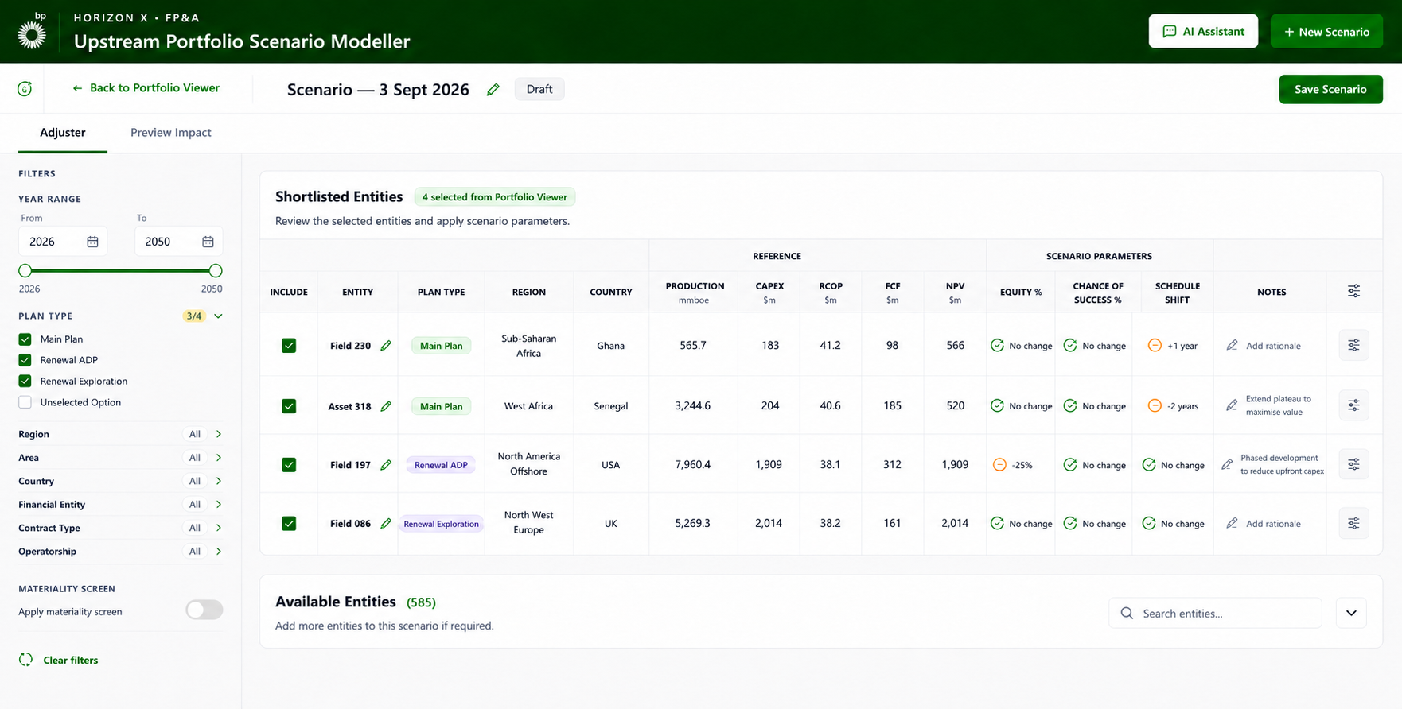
Build a scenario with configuration pane closed
PROPOSED DESIGN
CHANGE NOTES
1
Shortlisted entity workspace
Entities selected in Portfolio Viewer carry directly into the scenario workspace, preserving traceability
Table separates entity details, reference measures and scenario parameters for faster comparison
1
4
3
2
Available entities retained
Non-shortlisted entities stay accessible in a separate, searchable Available Entities section
Collapsed by default to maintain focus, while still allowing further entities to be added
3
Reference context for decisions
Read-only Production, Capex, RCOP, FCF and NPV measures show each entity’s scale and value before adjustment
Gives the context needed to make informed scenario changes
2
4
Controlled scenario configuration
Include status, Equity, Chance of Success, Schedule Shift and rationale stay visible at row level
Configuration control opens a contextual adjustment pane, keeping detailed changes out of the table

Slide 14
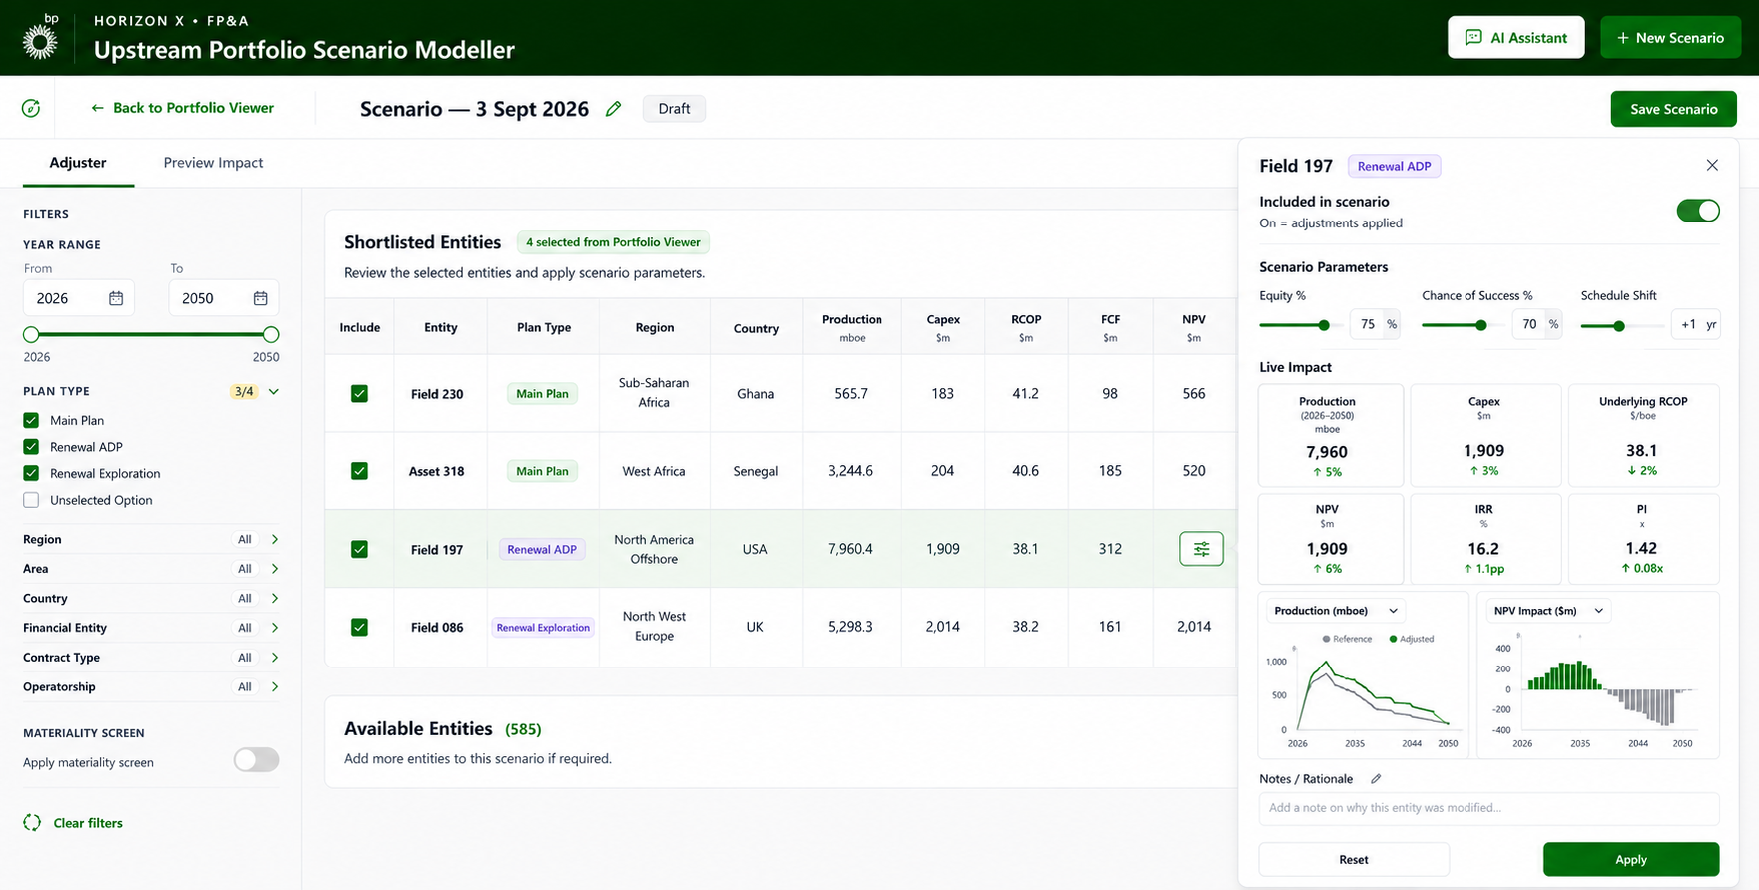
Build a scenario with configuration pane open
PROPOSED DESIGN
CHANGE NOTES
1
1
Contextual adjustment pane
Opens from the selected entity row and overlays the parameter area without resizing the table
Active row stays highlighted, with Entity and Plan Type visible to preserve context
2
2
Controlled parameter inputs
Inclusion toggle makes clear whether the entity’s adjustments will be applied
Equity, Chance of Success and Schedule Shift change independently, with current values shown
3
3
Immediate impact preview
KPI cards quantify the effect on Production, Capex, RCOP, NPV, IRR and PI before changes are applied
Configurable charts compare reference and adjusted profiles and show the annual NPV impact
4
4
Rationale and confirmation
Notes capture the business rationale for each entity-level adjustment
Reset and Apply separate testing from commitment, reducing unintended changes

Slide 15
04
PROPOSED DESIGN · SECTION 04 OF 04
Scenario Results
Review the Outcome
Compare the adjusted portfolio with the reference case and understand the contributing changes
Home
Portfolio Viewer
Build a Scenario
Scenario Results

Slide 16
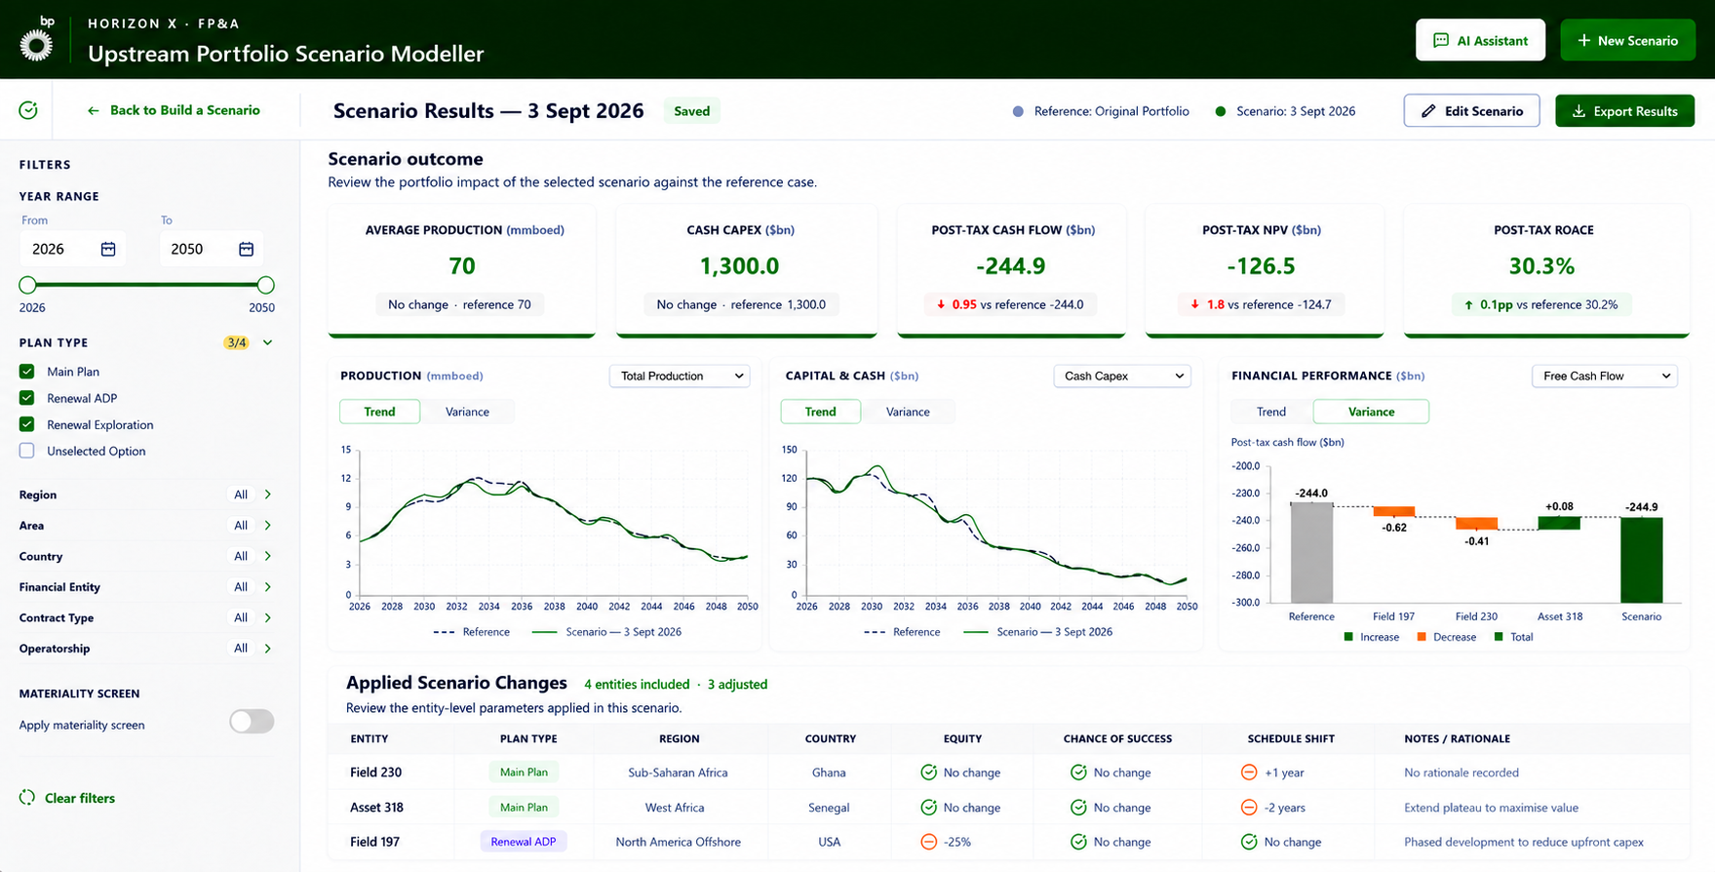
Scenario Results
PROPOSED DESIGN
CHANGE NOTES
1
Consistent results workspace
Standard filter rail and shared application layout restored
Outputs previously spread across screens consolidated into one KPI, analysis and detail hierarchy
2
1
2
Outcome-led KPI summary
Key outcome metrics presented in one summary row
Each card leads with the scenario result, with reference value and variance beneath
Financial measures use a consistent UOM basis
3
3
Selectable trend and variance analysis
Each visual switches independently between Trend and Variance views
Trend compares reference and scenario profiles over time; Variance reconciles the movement by entity
4
4
Traceable applied changes
Included and adjusted entity counts distinguished, with parameters and rationale retained
Editing stays in Build a Scenario, preserving results integrity

